Slide 1
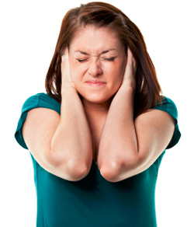
Sound Intensity
This lesson will introduce you to sound intensity
You will also learn about the decibel scale for measuring sound intensity level

Slide 2
Learning Goals
By the end of this lesson, you will be able to:
explain sound intensity
explain the factors that affect sound intensity
explain the decibel scale
determine the difference in sound intensity
identify factors that contribute to hearing loss

Slide 3
Success Criteria
Can I:
explain sound intensity
explain the factors that affect sound intensity
explain the decibel scale
determine the difference in sound intensity
identify factors that contribute to hearing loss

Slide 4
SOUND Intensity
The intensity, I, of a sound wave is defined as the rate of power that passes through a surface with area, A,
perpendicular to the wave’s direction.
Intensity can be calculated using the following eqn
the units for sound intensity are W/m².
sound waves radiate outwards in concentric spheres, we can replace A with the area of a sphere. A = 4πr²

Slide 5
as the distance increase, the sound intensity goes down by r².
so if the distance doubles, the intensity drops by four times

Slide 6
Decibel Scale
Humans have a very large range of hearing. We can hear noises with intensities of 10⁻¹² W/m² to 10⁰ W/m²
a logarithmic system called the decibel scale is used to measure sound intensity levels
The decibel unit of sound intensity is defined as:
where β is the sound level in decibels, dB. I₁ is the initial sound intensity (usually 1.0 x 10⁻¹² W/m²). I₂ is the final sound intensity.

Slide 7
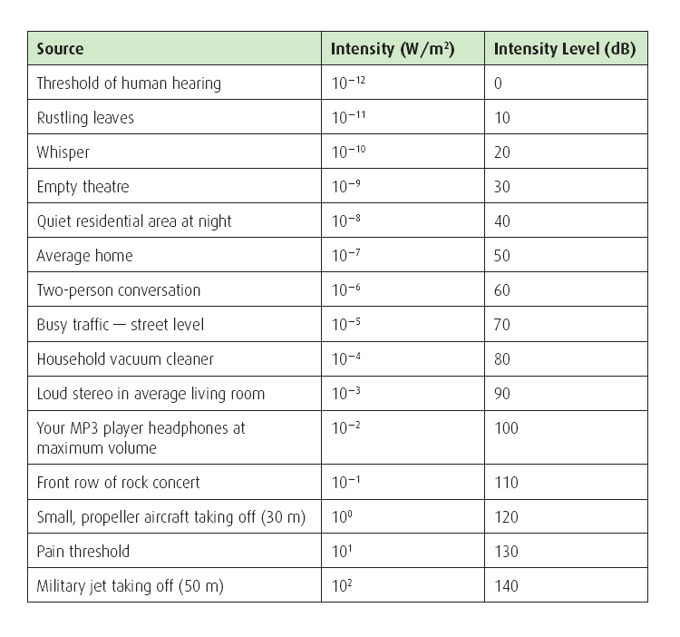

Slide 8
Sample Problem
A firecracker explodes producing a sound with
2.0 x 10⁻³ W/m². How many decibels louder is the firecracker than a normal conversation?
Sol’n:
I₂ = 2.0 x 10⁻³ W/m²
I₁ = 1.0 x 10⁻⁶ W/m²
β = ?
∴ The firecracker is 33 dB louder, so the
firecracker would have a sound level of 93 dB

Slide 9
a good rule of thumb to remember is:
When using the decibel scale, every 3 dB increase in sound level is a doubling in intensity. A 10 dB increase increases the intensity by 10 times

Slide 10
Noise, Music, and Hearing Loss
the Ontario Occupational Health and Safety Act (1990) sets the limit on exposure to noise
workers can be exposed to no more than 85 dB per eight hour shift.
exposure to more than 85 dB per eight hours can lead to permanent hearing lose
employers that subject their workers to more than 85 dB must, by law, provide their workers with appropriate ear protection

Slide 11
If workers are exposed to sound levels greater than 85 dB, then the exposure time is cut in half for every 3 dB over the 85 dB
so a worker exposed to a sound level of 88 dB can only work for four hours
a work exposed to 91 dB can only be exposed for two hours, etc.

Slide 12
HOMEWORK
Read Section second half of 8.5
Questions 2 – 10 pg 397

